Slide 1
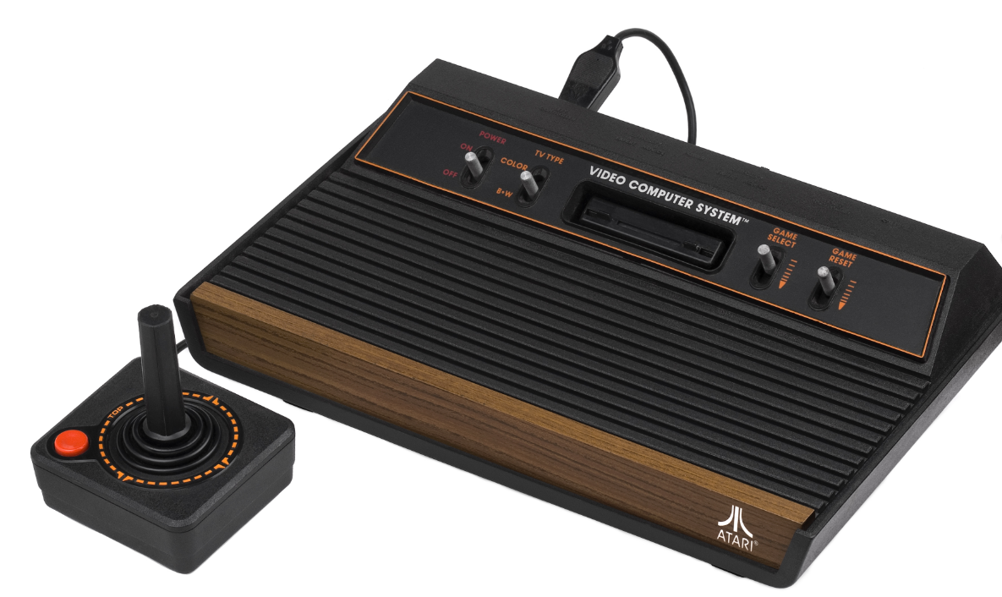
The Atari 2600: A Turning Point in Home Technology
History, Impact, and Legacy.
By: Izabella Martinez, Caitlyn Edwards, and David Young

Slide 2
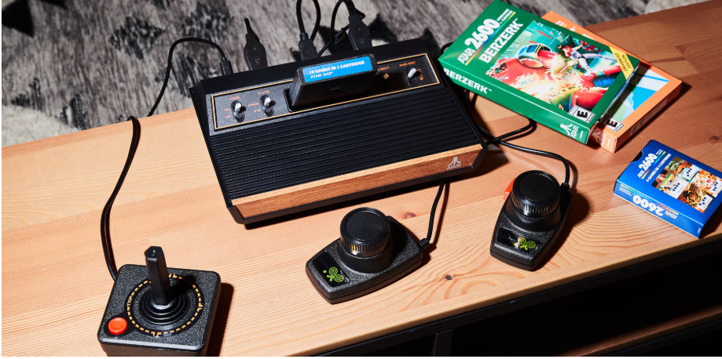
What is the Atari 2600?
Released in 1977 by Atari
One of the first home consoles
Used swappable game cartridges
Sold millions of units worldwide
Became a major pop culture icon.

Slide 3
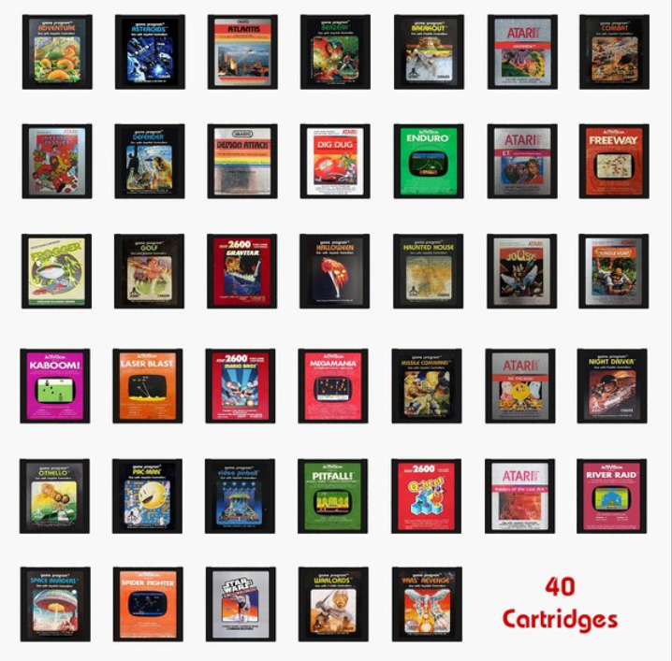
Why it matters!!
Made video gaming affordable and accessible
Introduced modular games (cartridges)
Helped shape the home tech industry
Influenced later consoles’ design and structure
Created a new form of family entertainment.

Slide 4
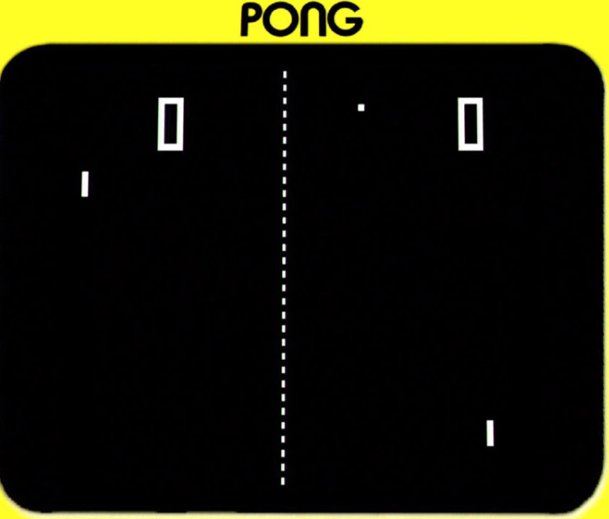
Before the Atari 2600
Home consoles had only one built-in game
Mostly Pong-style systems
Little variety or creativity in games
No long-term software library
Atari changed the model with expandable gameplay.

Slide 5
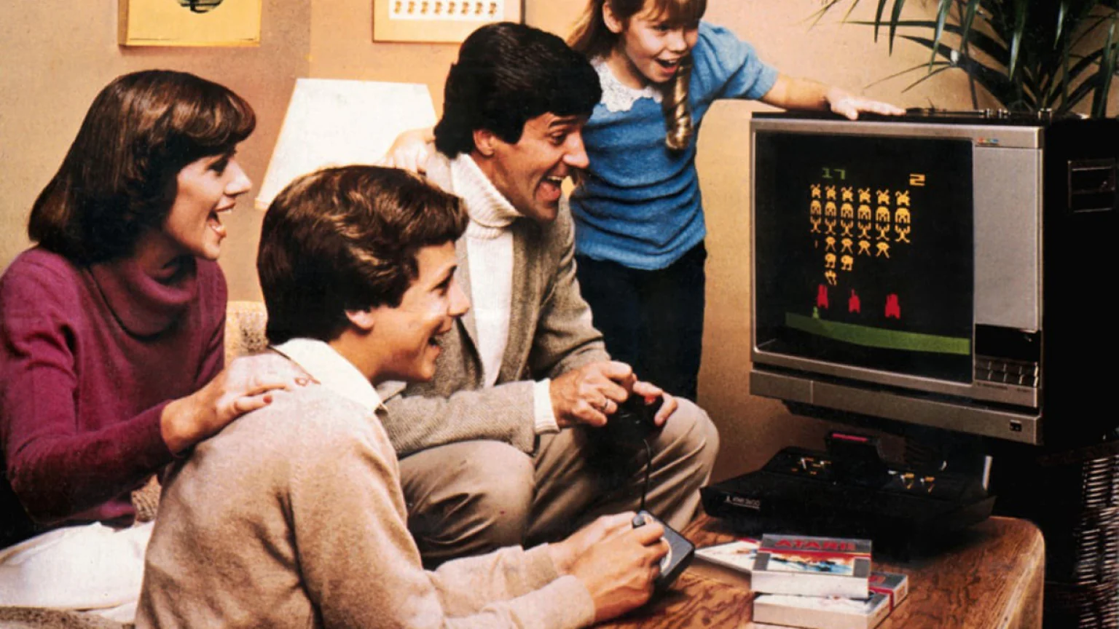
Rise in popularity and cultural impact
Popularization of interchangeable cartridges
Staying competitive in a saturated market
Arcade games → home consoles
Image of family enjoying the Atari 2600 at home gaming system. Courtesy of Atari Inc.
Fleury, James. “From Superman to Swordquest: Atari and Early Video Game Labor Exploitation.” The American Journal of Economics and Sociology 83, no. 5 (2024): 955–65.
Lisy, Brandon, Justin Beach, Ted Dabney, Nolan Bushnell, Allan Alcorn, and production company Bloomberg LP. The Great Disrupters. How Three Men and a Bar Launched the Video Game Industry. New York, NY: Bloomberg, 2014.
Newman, Michael Z. Atari Age : The Emergence of Video Games in America. Cambridge, MA: MIT Press, 2017.

Slide 6

“Have You Played the Atari Today?”
One of Atari’s 1981 series of commercials, with this one featuring Space Invaders.

Slide 7
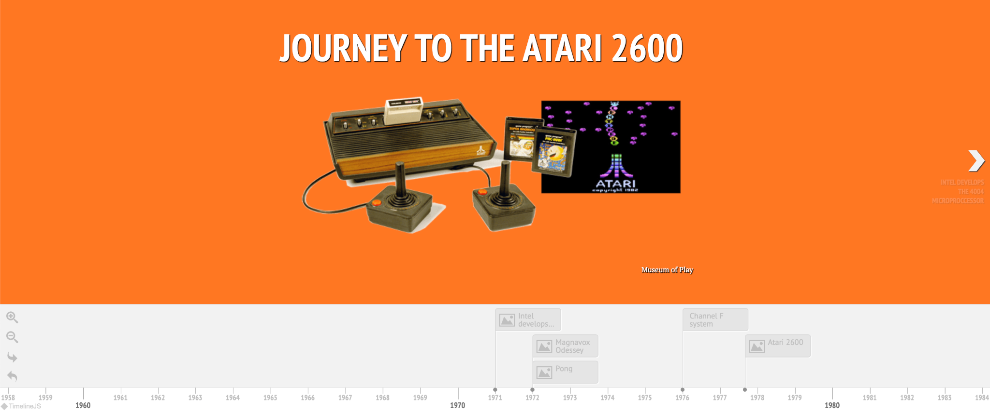
Timeline made using TimelineJS, visual addition to our project.

Slide 8
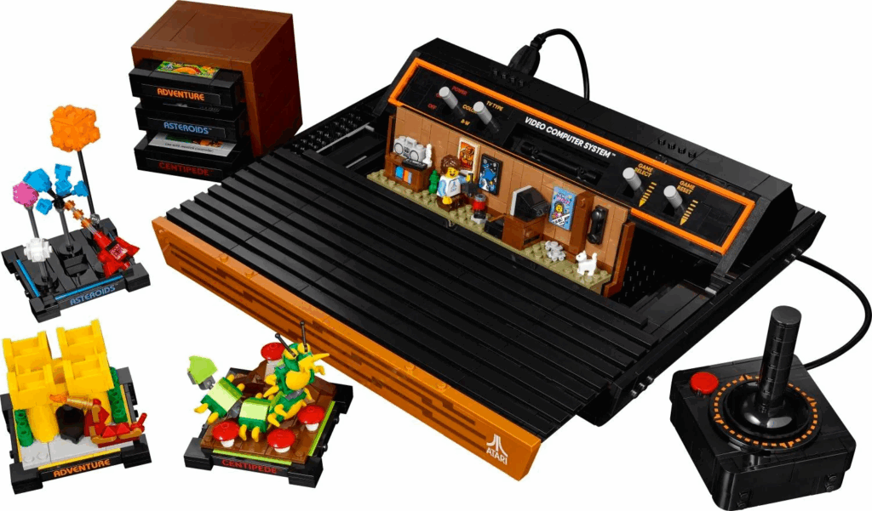

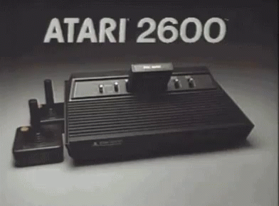
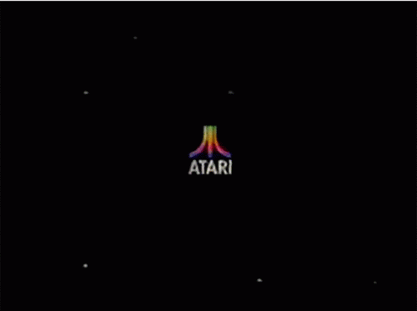
Thank you!!!

